Slide 1
2024
A Review on Application of Edge
Computing in IoT
reporter：代翔
time：2024.4.9

Slide 2
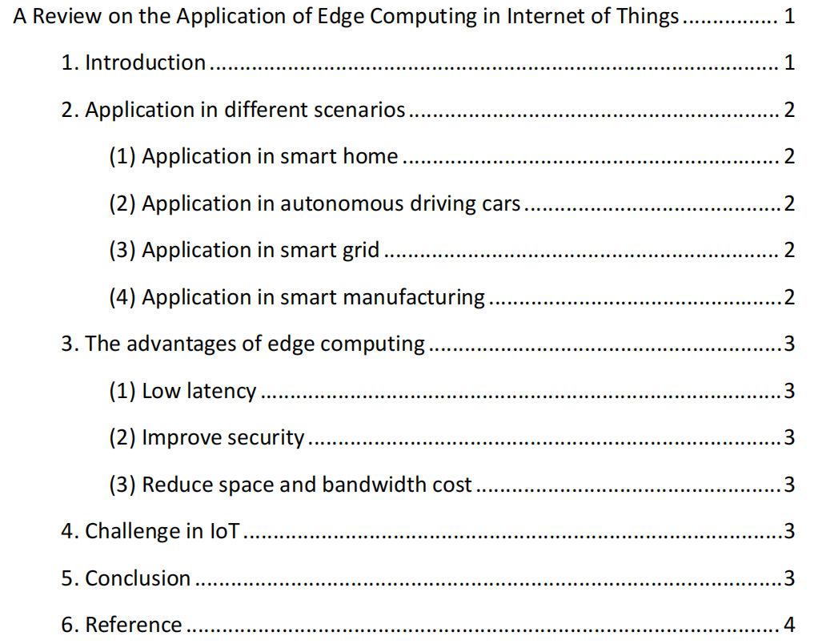
行业PPT模板http://www.1ppt.com/hangye/
CONTENT

Slide 3
1
Introduction

Slide 4

A vedio about IoT in life

Slide 5

What is IoT and Edge computing?
IoT
Internet of Things technology refers to connect everything through sensor and internet and sent the data to the platform,and then using cloud computing empower things with intelligence.
Edge computing
It is a computing mode that is physically close to the source of the network edge detection, an open platform that integrates the core capabilities of the network, computing, storage, and application, and provides edge intelligent services nearby.
The octopus uses its legs to think because the octopus has 60% of its neurons in its legs and only 40% of its neurons in its brain

Slide 6
2
Application in different scenarios

Slide 7
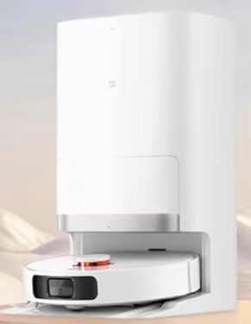
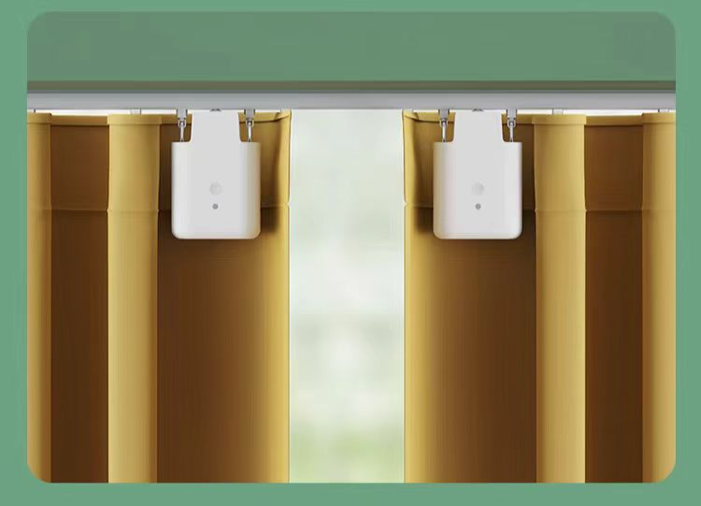
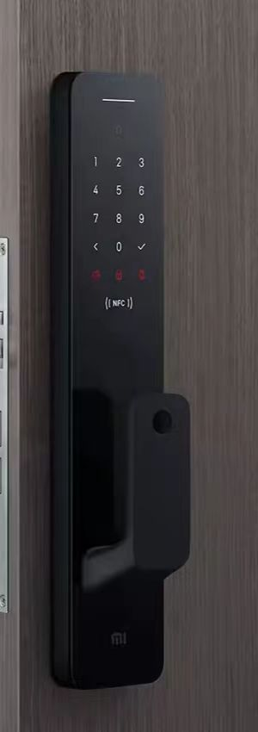
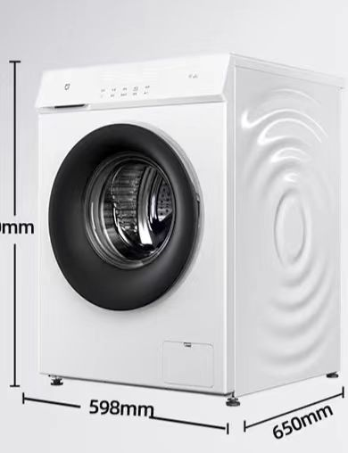
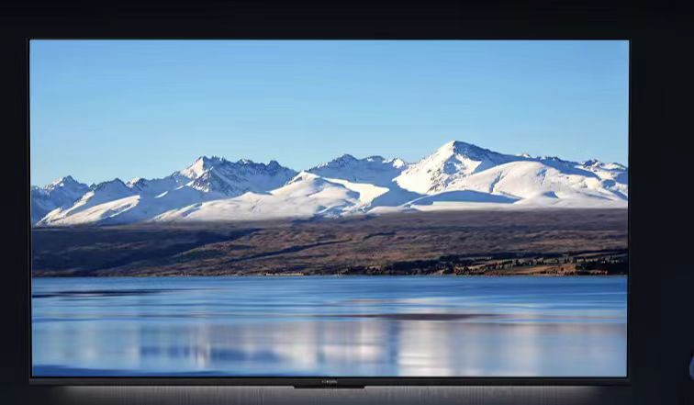
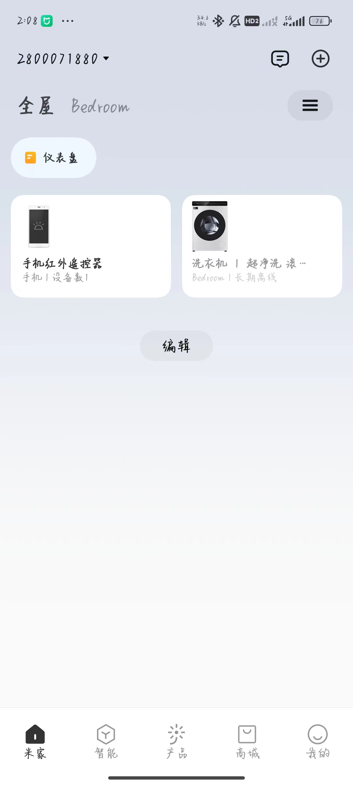
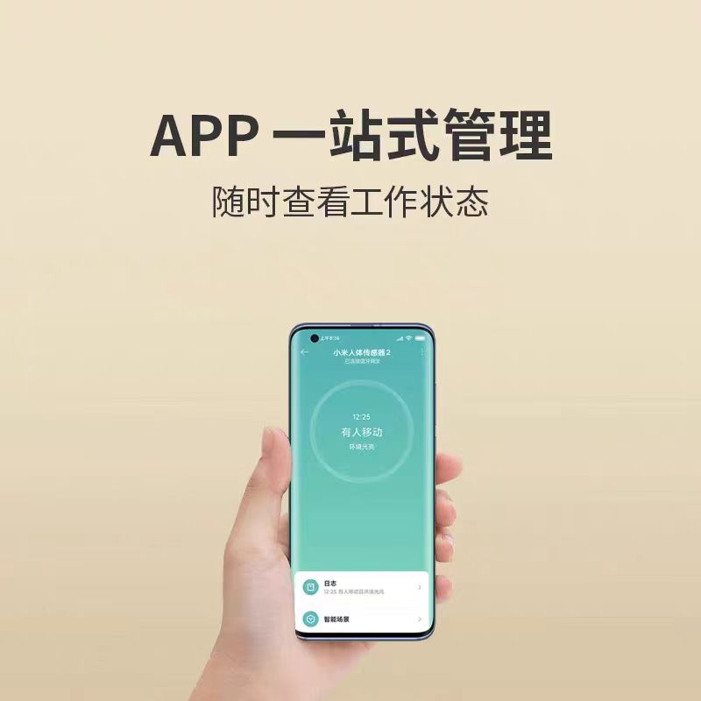
Application in smart home

Slide 8
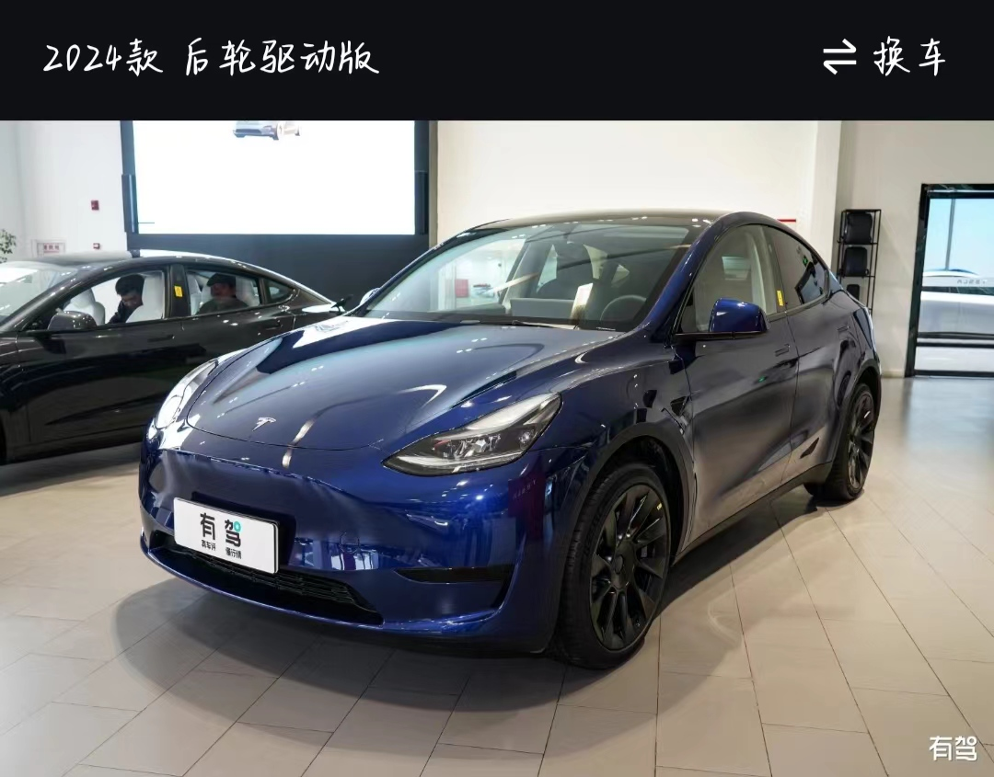
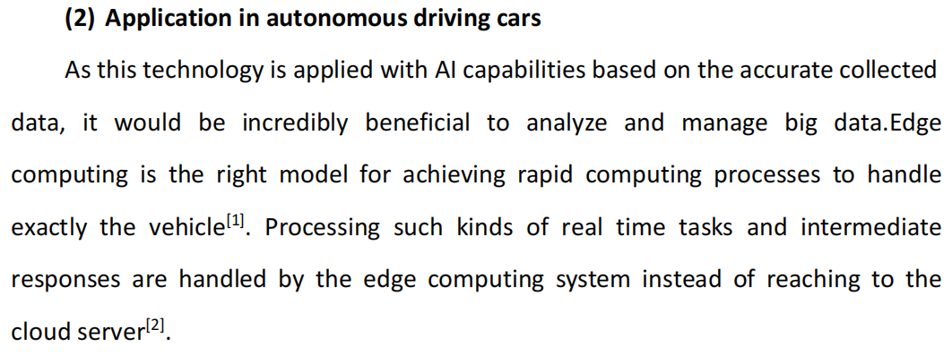
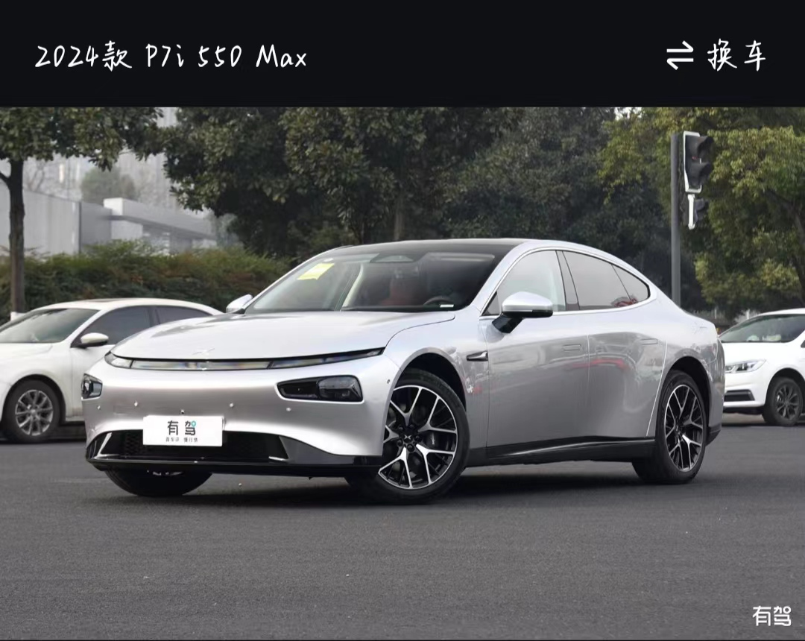
Application in autonomous driving cars

Slide 9
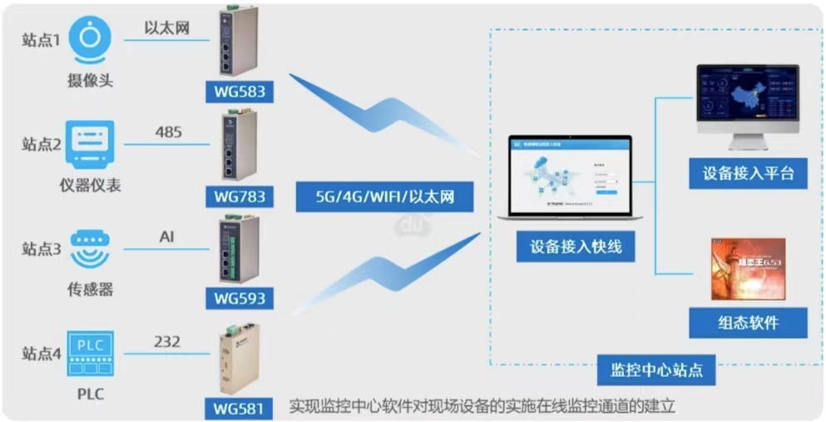
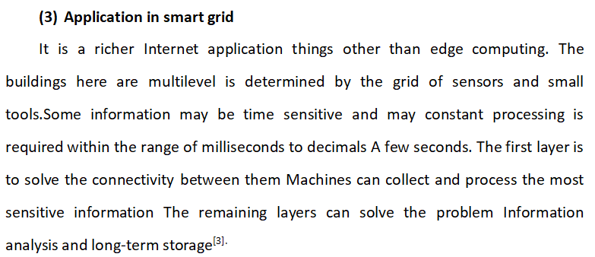
Application in smart grid

Slide 10
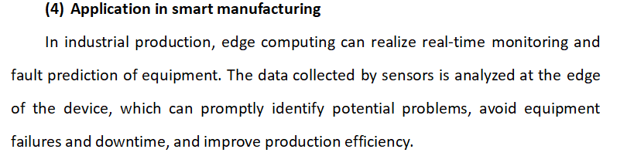
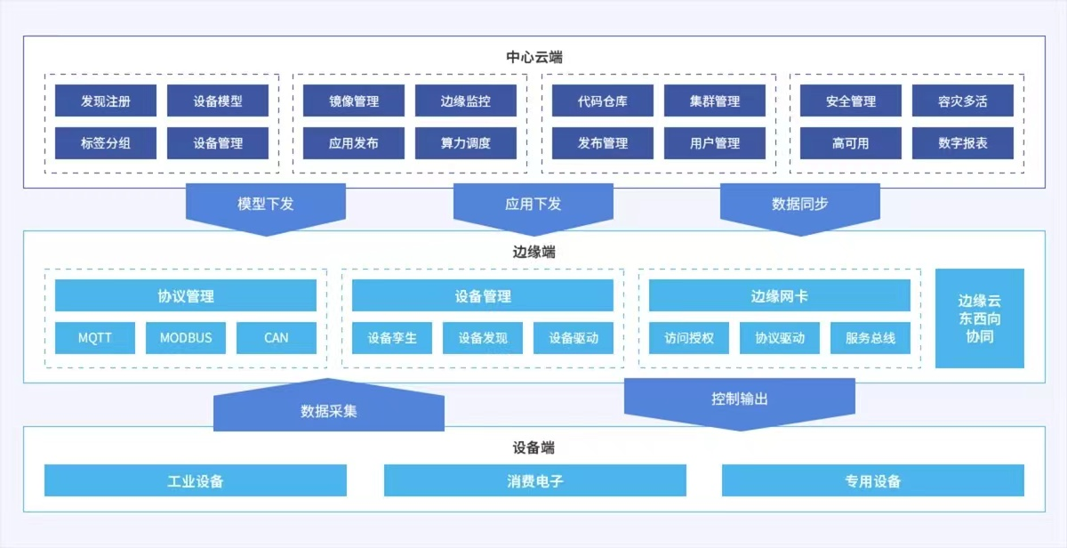
Application in smart manufacturing

Slide 11
3
The advantages of egde computing

Slide 12
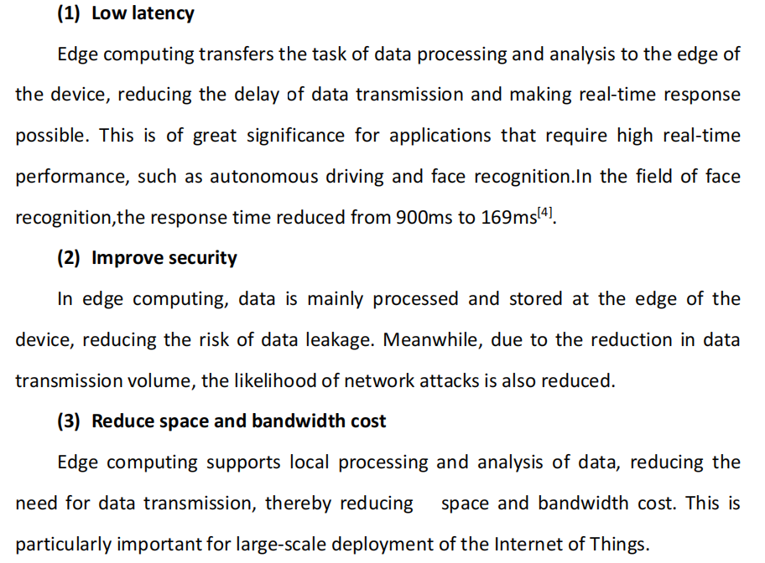
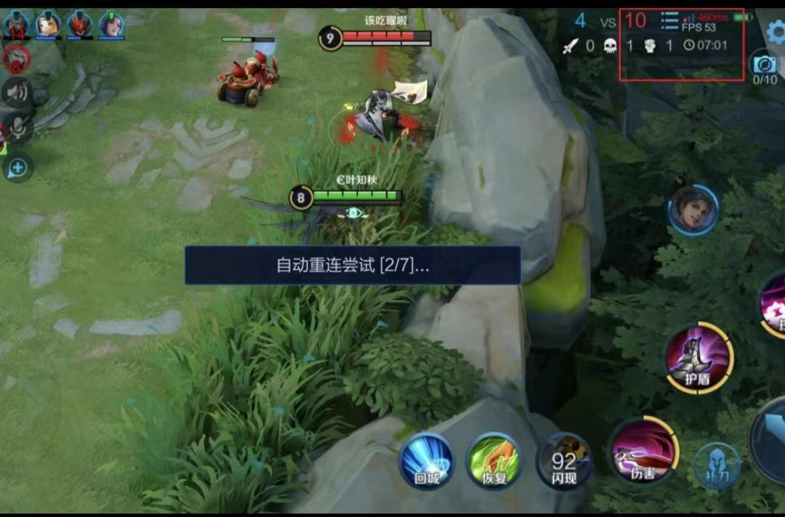
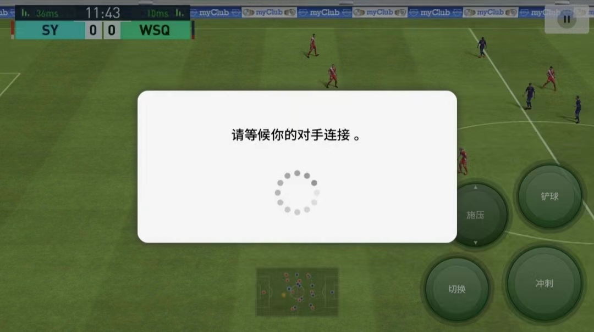
Advantages

Slide 13
4
Challenge in EdgeComputing

Slide 14
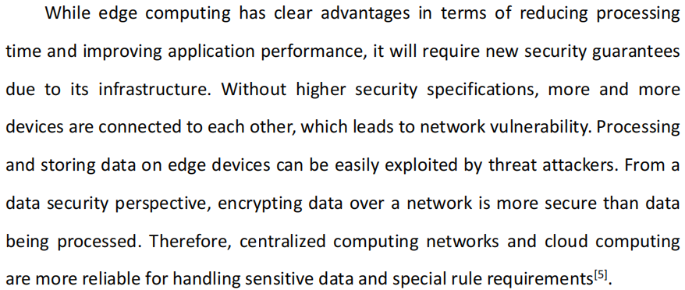
Challenge in EC

Slide 15
5
Conclusion

Slide 16
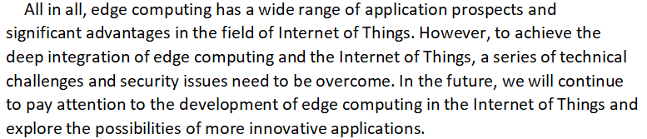
Conclusion

Slide 17
6
Rference

Slide 18
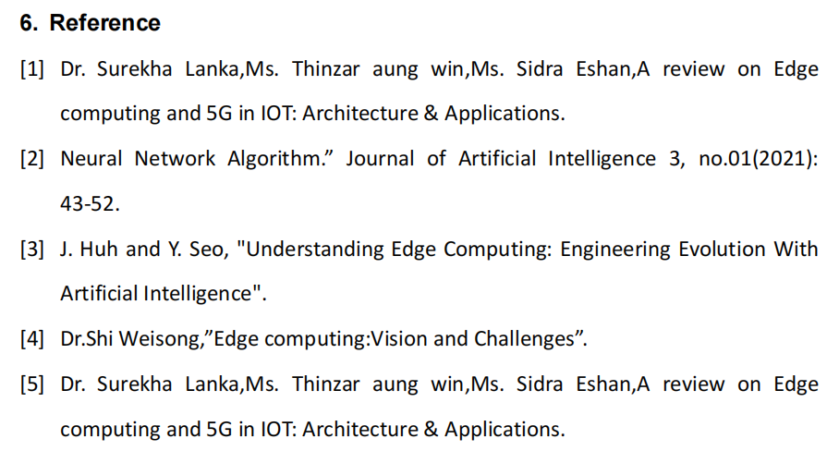
Reference

Slide 19
2024
Thank you for
watching
reporter：代翔
time：2024.4.9

